Slide 1
Web Fundamentals
By Issoufou Henri Rachid

Slide 2
How Does the Web Work?
The World Wide Web or the Web is a system of interconnected pages and resources, accessible via the internet.
The key components of the Web are:
The Web Browsers which allow users to view and interact with web pages.
The Web Servers which store the web pages and handle requests.
URLs that help browsers find web resources.
The Protocols for communication between web servers and browsers (HTTP/HTTPS)

Slide 3
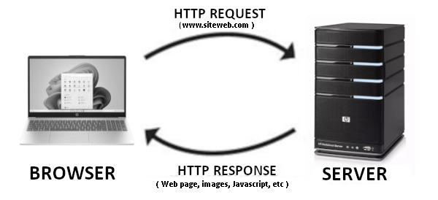
How it works: When you enter a URL, your browser sends a request to the web server. The web server then processes this request and returns the requested data (HTML, CSS, JavaScript files). Finally, the browser displays the information to the user.

Slide 4
What Do You Need to Be a Web Developer?
Becoming a web developer requires some knowledge of web development. The basic knowledge are:
HTML (HyperText Markup Language)
CSS (Cascading Style Sheets)
JavaScript
A web developer need some tools to work
A text Editor
A Browser

Slide 5
Why Did You Choose to Learn Web Development?
I became passionate about web development after seeing high-quality websites and web applications. Designing these types of sites myself made me want to learn web development.
Today, thanks to the accessibility of resources and tutorials, it is easy to learn web development.
The tech world constantly evolves, offering many opportunities for growth and skill improvement.

